Slide 1
Funding Your Research For Pediatric Epilepsy 5 May 2023
Zachary Grinspan, MD MS
Associate Professor
Interim Chief, Child Neurology
Director of Pediatric Epilepsy
Department of Pediatrics, Neurology, and Population Health Sciences
zag9005@med.cornell.edu

Slide 2
Disclosures
Research funding from
Weill Cornell Medicine
Pediatric Epilepsy Research Foundation
BAND Foundation
STXBP1 Foundation
SLC6A1 Connect
Orphan Disease Center (CHOP)
Clara Inspired
Morris and Alma Schapiro Fund
Laitman Clinical Scholars Program
Center for Disease Control and Prevention (U01DP006089)
National Institute of Neurological Disease and Stroke (R01NS130113)
Horizon Therapeutics (provision of medication for clinical trial)
Consulting: Capsida Biotherapeutics, Encoded Therapeutics, Neurvati Neurosciences

Slide 3
Objectives
Outline the essential elements that are common to most grant applications
List potential funding sources (and how to find them) – including sources for non-US citizens
Identify sources of ideas for research proposals
Describe the differences between research grant and mentored career development grant applications
Guidance on questions related to health disparities and social determinants of health

Slide 4
Essential elements of grant applications
Core Science | Aims Page
 | Significance / Innovation
 | Methods
Supplemental Science | Limitations & Mitigation
 | Next Steps
 | Deliverables / Dissemination Plan
 | Timeline
 | Abstracts / Lay Summary
 | Protection of Human Subjects
Finances | Budget
 | Budget Justification
Supporting Documents | Letters of Support
 | Biosketches
 | Facilities
 | Other regulatory
 | Subcontract ppw

Slide 5
A note about costs
Grants may provide direct costs and indirect costs
Direct costs are for you and your research (salary, equipment, travel, etc.)
Indirect costs are for rent, utilities, office expenses
In academic institutions, indirect costs are often charged by the college/university as a percentage of the direct costs.
Some grants are direct cost grants, which means the indirect costs are granted in addition to the costs of your research.
Some grants are total cost grants, which means that you must pay for both direct and indirect costs from the total amount awarded.

Slide 6
Funding Sources for Epilepsy Research
Federal (NIH, CDC, HRSA, DOD)
Pros: Large grants available, Substantial indirect costs, Prestige, Robust review process, Multi-year
Cons: Competitive, High regulatory burden
Professional Societies (AAN, AES, CNS) & Foundations (CURE, PERF, LGSF, DSF, etc.)
Pros: Infrastructure, Training, Less competitive, Less regulatory burden
Cons: Short time, Small to medium $, small indirects, less robust review
Philanthropy
Pros: Less oversight, funding amount can be large
Cons: Driven by relationships, subject to funder’s interest

Slide 7
How to find grants
Reporter.nih.gov
spin.infoedglobal.com
Grants.gov
Grantome.com
Proposalcentral.altum.com
Foundation website
Word of mouth / mentors
Listservs (NIH, AES, CNS, institutional)

Slide 8
Non-US Citizens/Residents
May need to file a US tax return
May need a taxpayer identification number (TIN) or employer identification number (EIC)
Less availability of federal training grants (K08 K23 etc) except K99/R00
Some foundations have limitations
Key: CHECK ELLIGIBILITY REQUIREMENTS

Slide 9
How to find ideas
Talk to people (bench neuroscientists, clinicians, mentors, peers, patients, funders, project officers, etc…)
Be a good collaborator
What else has been funded?
Pitfalls:
Mismatch of funder and proposal
Collaboration failure

Slide 10
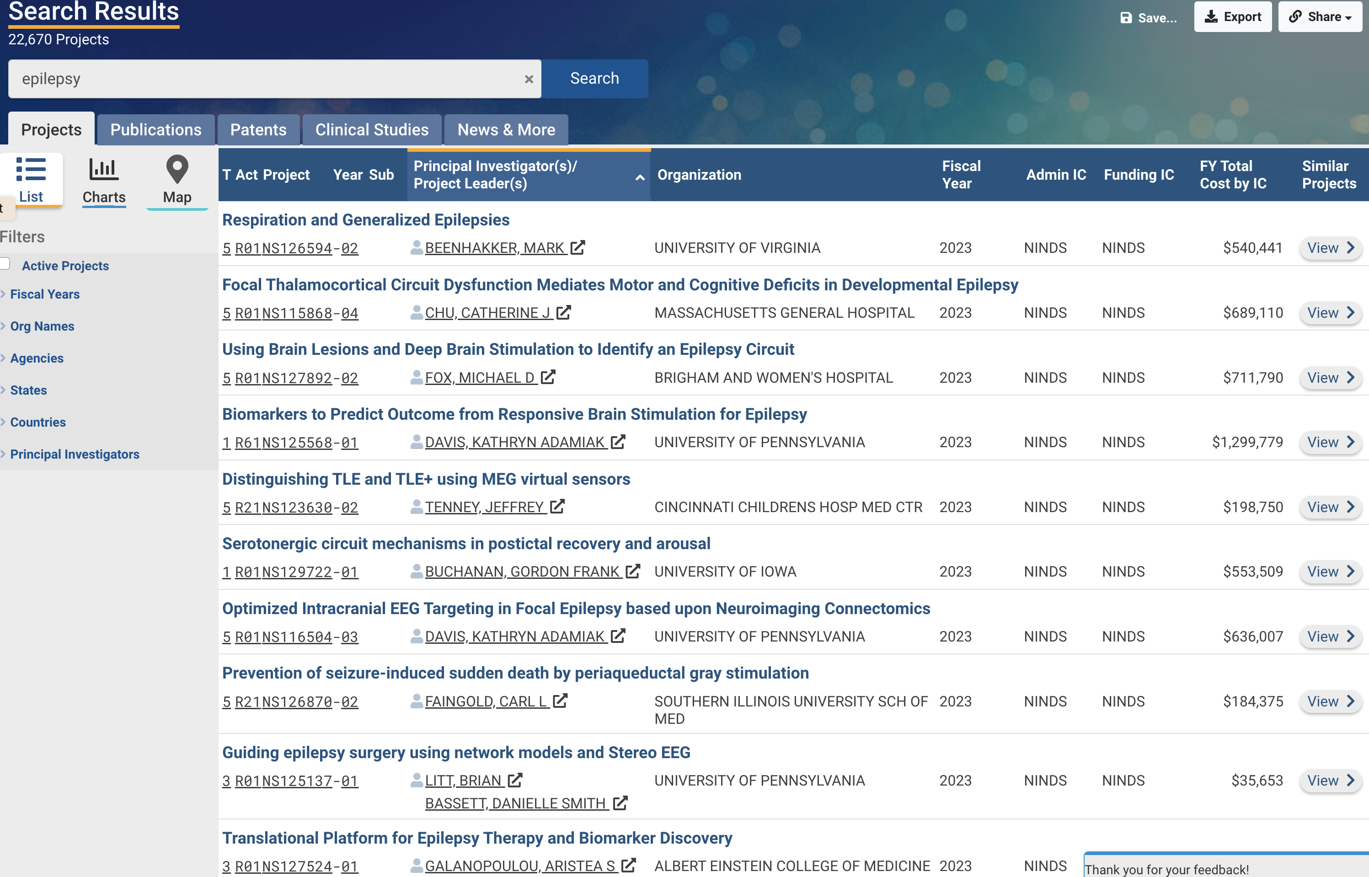

Slide 11
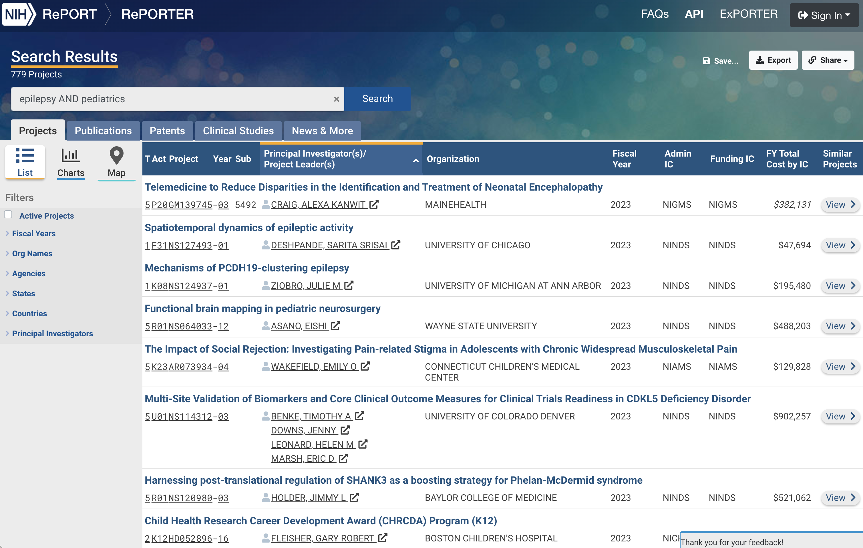

Slide 12
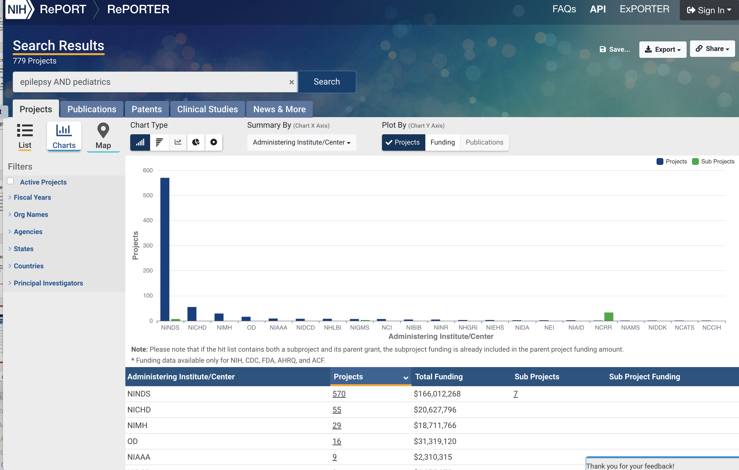

Slide 13
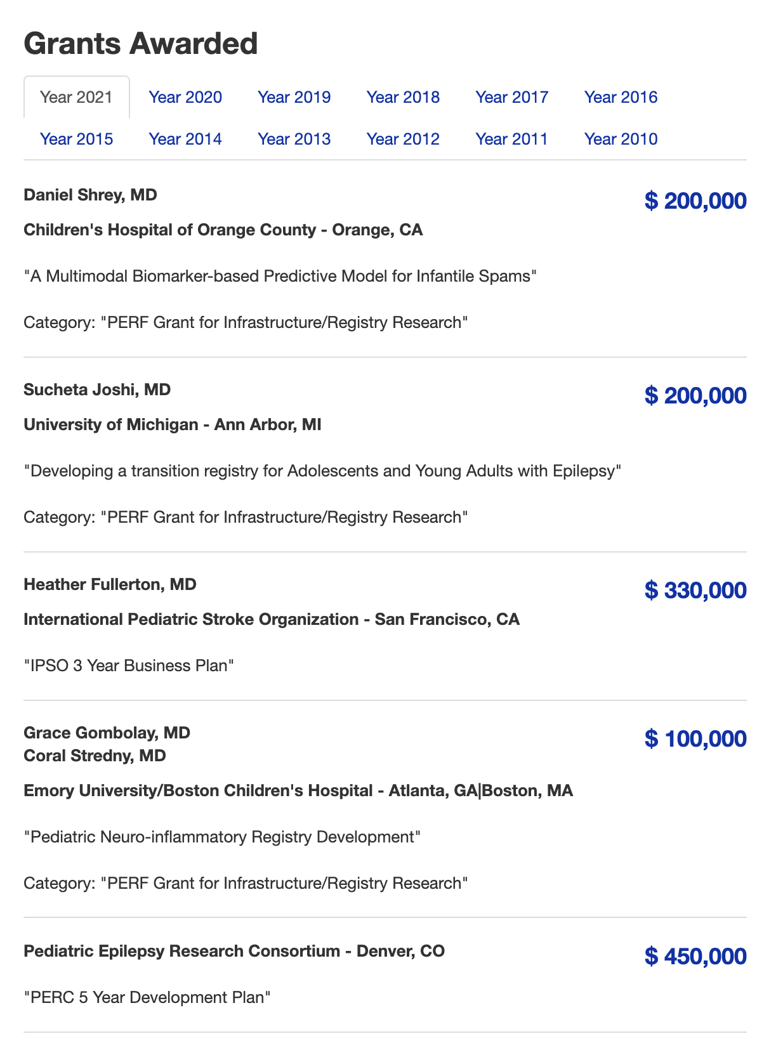

Slide 14
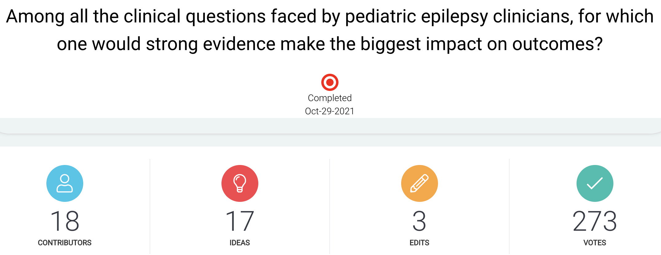
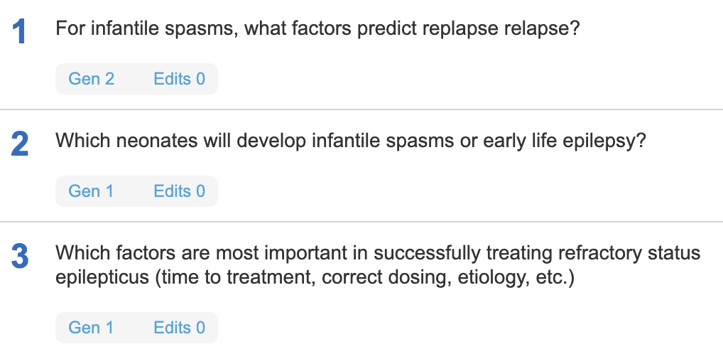

Slide 15
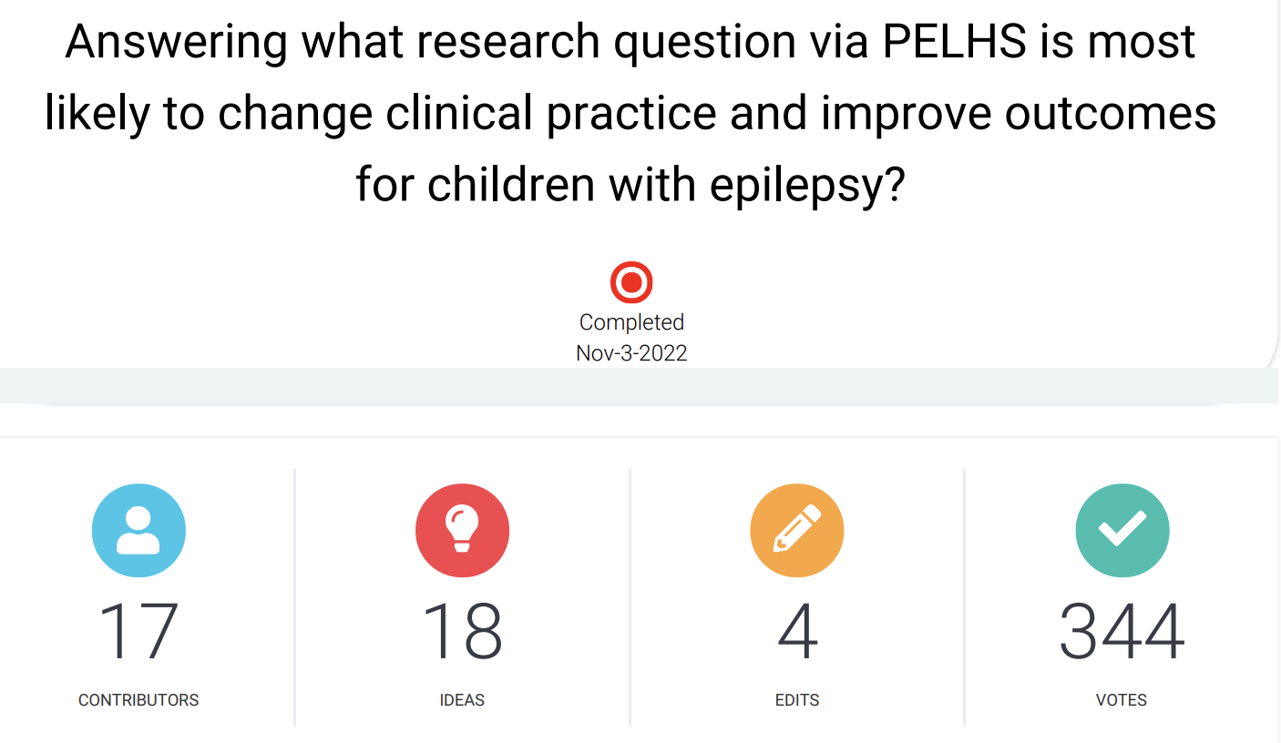
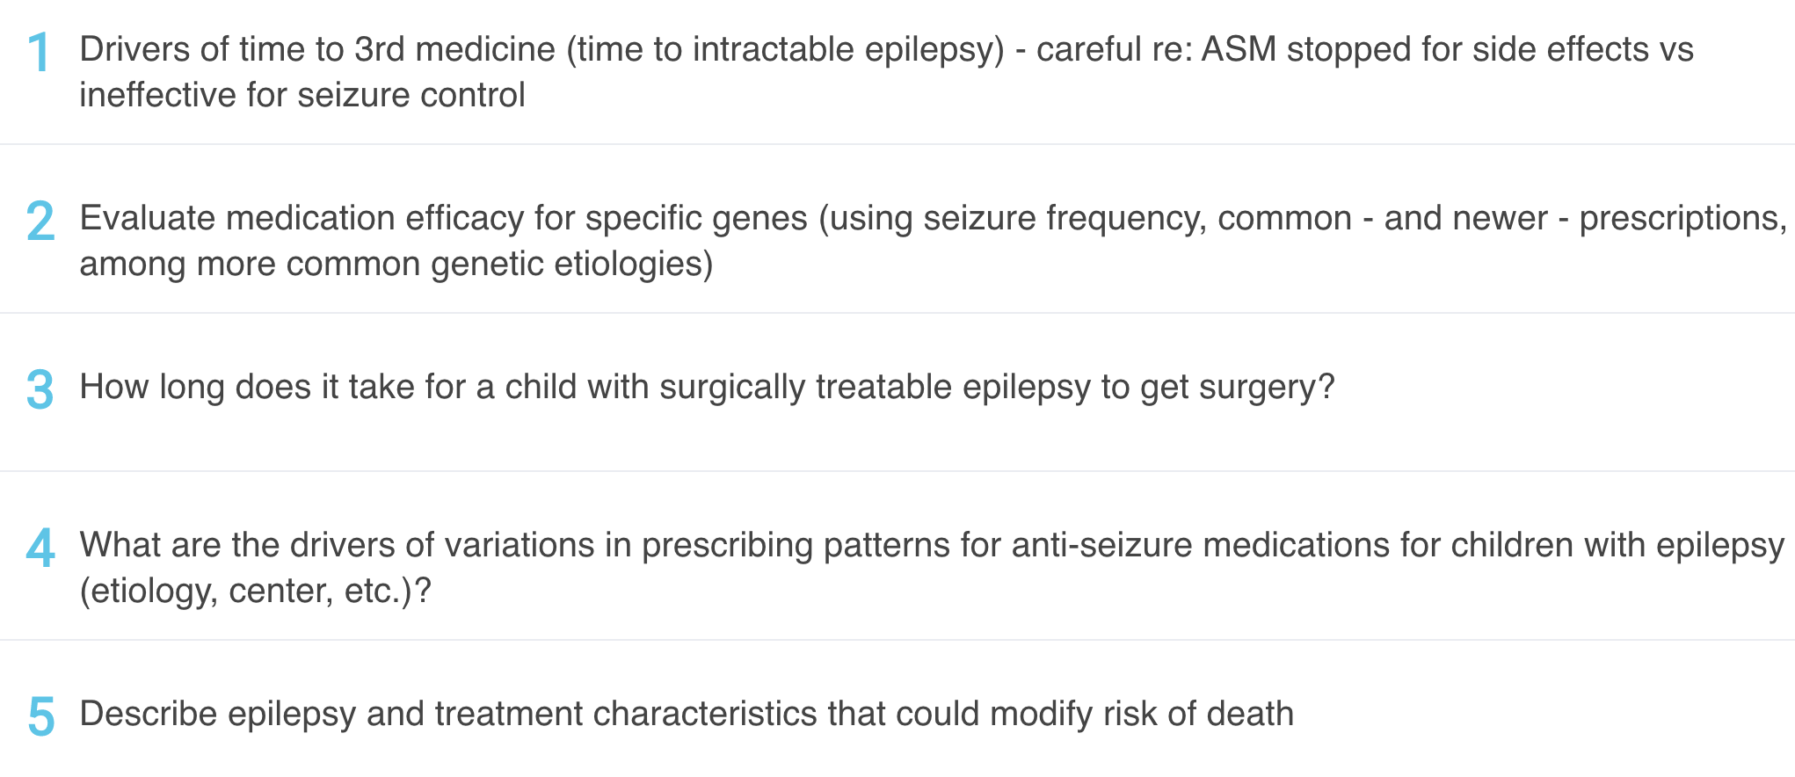

Slide 16
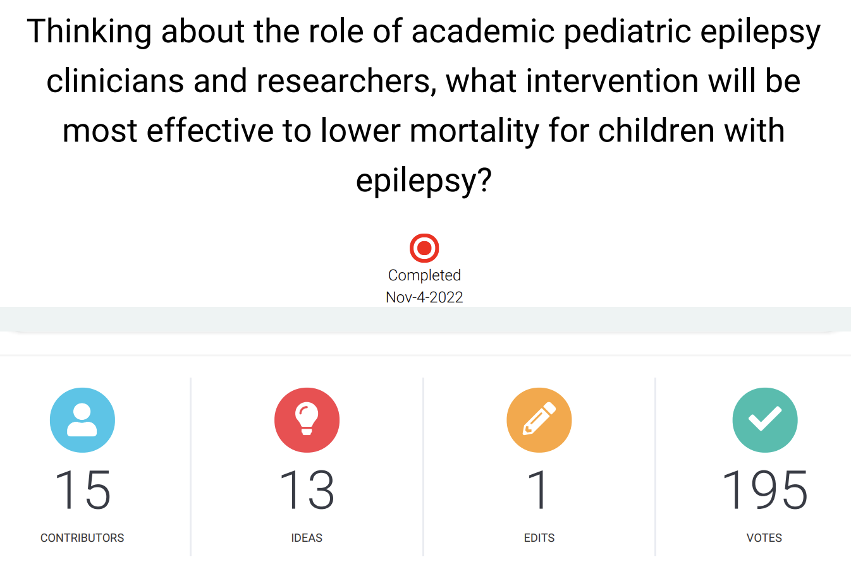
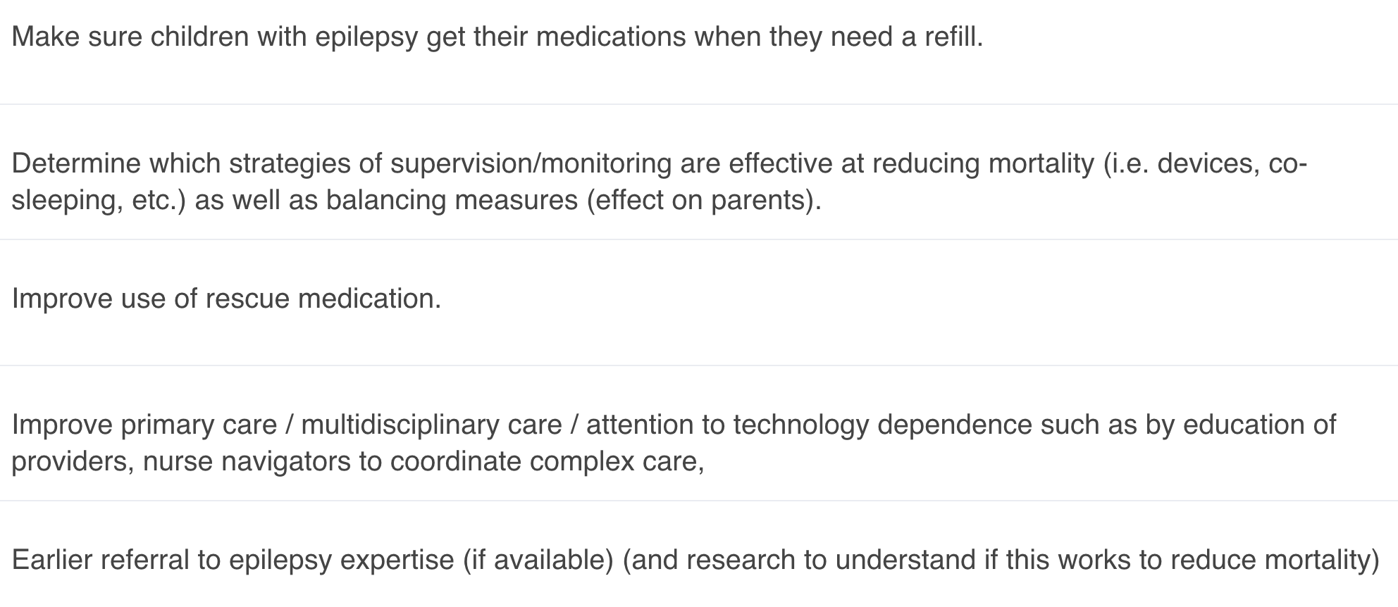

Slide 17
Training Grants / Career Development Awards
Foundations / Professional Societies
AES – early career funding
AAN – career development award
Child Neurology Foundation – Elterman / Shields Grants
NIH
K08 (bench) / K23 (clinical)
K02 (independent)
K99/R00 (“kangaroo”)
Pros: Protected Time
Cons: Small indirects – you are still being supported
Pitfalls: Not enough time spent on mentorship, career development plan

Slide 18
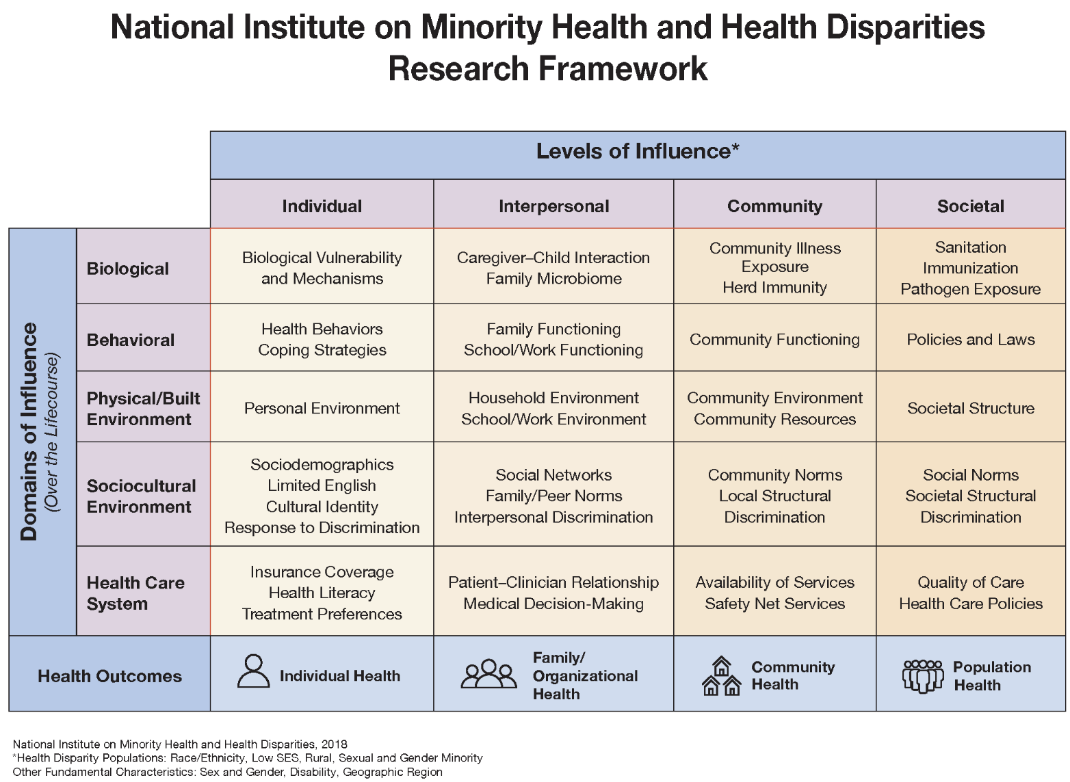
Social determinants of health and health disparities
Recruit a diverse team
Link to a framework
The disparities are there – think about interventions (“specific action”)

Slide 19
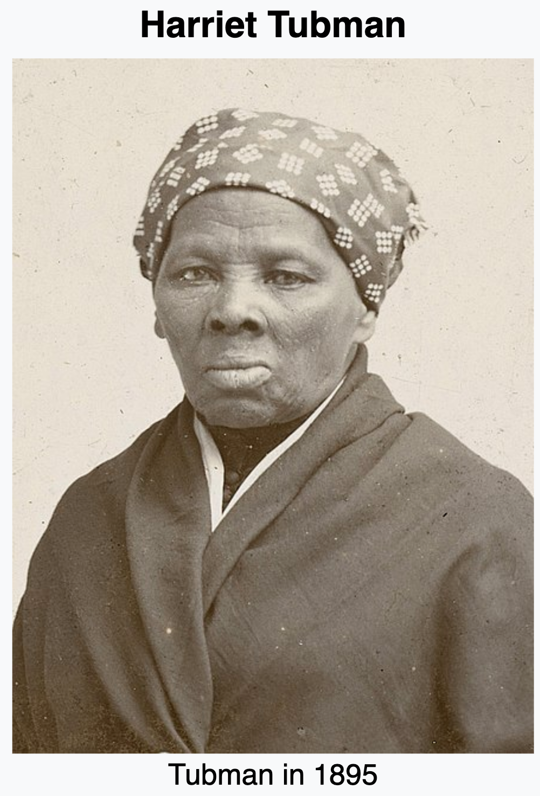
Pitfalls & Guidance
Language and Bias
DON’T equate “Black” = “poor”
DO acknowledge personal biases & effect of media
DO capitalize “Black”
Statistics
DO acknowledge bivariate analyses
DON’T assume disparities reflect an interplay between center-to-center variations in care and variations in racial makeup of the local population
DO consider a broader review of the full treatment pathway
Study Design & Team
DO include collaborators with lived experience
DO consider a broader review of the full treatment pathway
DO link to a framework
DO consider narratives of resilience
DO consider specific actions to address disparities

Slide 21
Three Highest Ranked Ideas
Qualitative Research
(1) Identify the healthcare disparities faced by minority children with epilepsy. For example, do they have the same opportunity to use newer antiseizure medications, enter clinical trials, try dietary therapy, and be evaluated for epilepsy surgery?
(2) Perform qualitative research that incorporates/engages the experienced families from minority and underserved communities to understand the mechanisms behind health disparities in pediatric epilepsy care, and to generate ideas for solutions.
Quality Improvement
(3) Draft, pilot, revise, and implement quality measures to track and improve health disparities in pediatric epilepsy care.

Slide 22
Recommended Exercise
List 5 – 10 possible sources of funding. For each source, write a few sentences describing the opportunity and how it would fit your career. Include
Purpose of the grant
Target audience
Dollar amount
Number of years
Key submission dates
Potential grant ideas
When / why you might apply
Reflections on pros / cons

Slide 23
THANK YOU!!!!!!!

